Slide 1
MINI-PROJECT
ON
ECOMMERCE WEBSITE
HANDLOOM FASHION
( USING HTML & CSS)

Slide 2
Power of an Ecommerce Website
With the ability to do shopping at the comfort of your home with just a few clicks on your smartphone, e-commerce has changed the outlook of the marketplace. People no longer have to plan shopping or worry about fuel and traffic while driving to a nearby mall to purchase their perfume, tie, garments, etc. They have to log in to the company's website and place their order with the convenience of "Cash on Delivery (COD)" primarily available.

Slide 3
The Benefits of an Ecommerce Website
Increased Customer Reach
Sales Opportunities Always Open
Low StartUp and Maintenance Costs
Flexibility to Run the Business from Anywhere
Go International with Ease

Slide 4
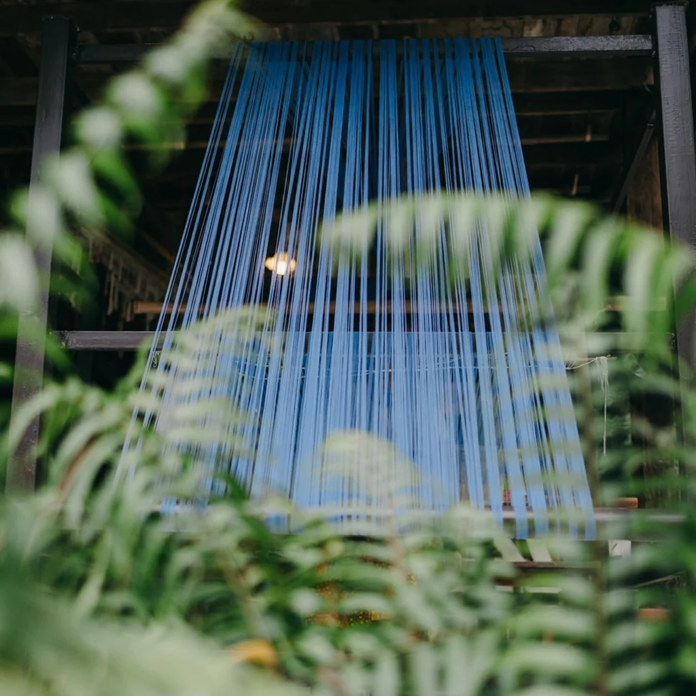
What are handloom fabrics?
Handloom fabrics are handwoven fabrics created on a weaving device called a loom. The process involves entwining a set of vertical threads, the ‘warp”, with a set of horizontal threads, the ‘weft”.
The loom holds the warp threads under tension to facilitate the interweaving of the weft threads over and above the warp using a weaving shuttle. This is done repeatedly to create the handloom fabric.
Handloom weaving is a labour of love as much as it’s a source of livelihood. It requires utmost patience, artistry, and technical skills not to mention physical strength!
The weaver’s hand is at the heart of this intricate process. They select the yarn, pattern, colour, texture, and precise technique to create their desired aesthetic.
The fabric carries the energy and personality of the weaver and it becomes part of the garment’s story.

Slide 5
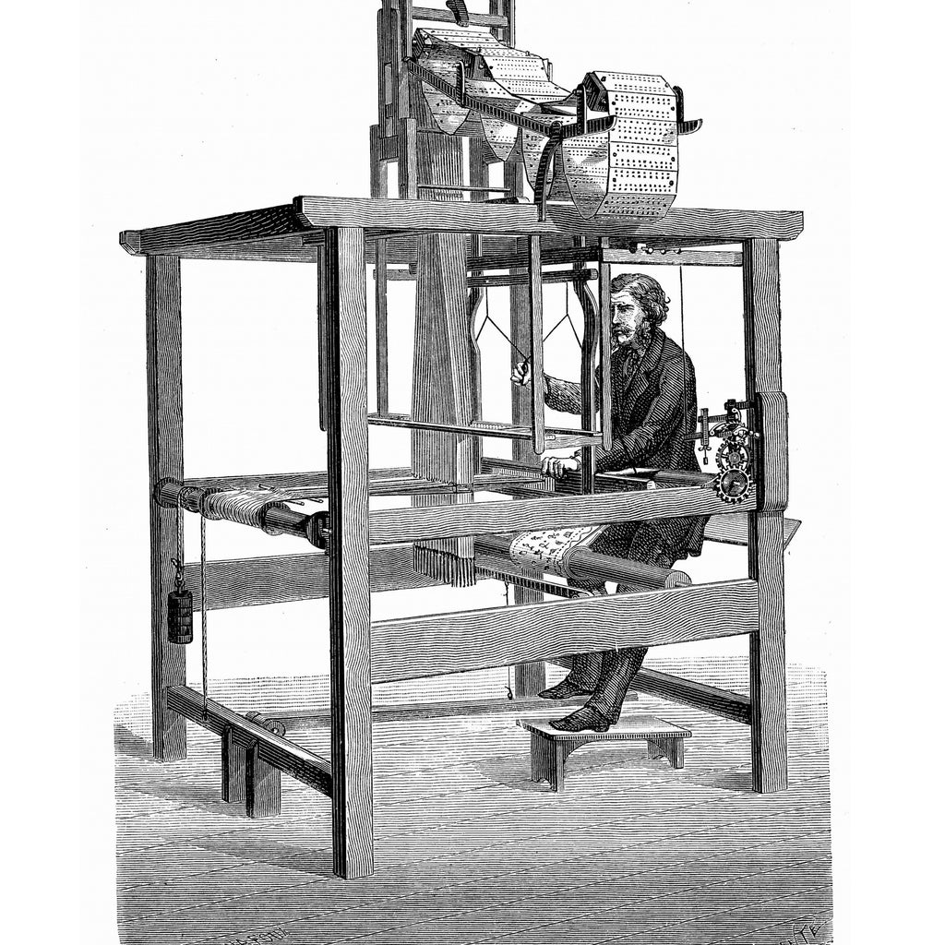
RARE & FAIR
FASHION
The handloom industry was booming until the power loom showed up. The electrical powered machine produces 5 times more fabric and displaces 14 handloom weavers with each job created.
The good news is that there are millions of weavers around the world still pursuing their passion for handlooms. The onset of the slow fashion movement has meant many consumers seeking handloom fabrics that support both the planet and the people that make them.
More renowed fashion designers, such as Atelier Pichita and Sabyasachi Mukherjee, are also bringing handlooms back into fashion by featuring them in their collections and giving them a modern and contemporary appeal.

Slide 6
Advantages of handloom fabrics
Uniqueness
Variety
Quality
Comfort
Skill preservation
Important source of livelihood
Eco-friendly

Slide 7
Handloom Fabrics - Final thoughts
Although the practice of handloom is viewed as a fading art, there’s still hope for the future of the industry. There have been initiatives over the years that have increased the visibility and viability of the craft.
Social media awareness campaigns through popular hashtags such as #IloveHandloom and #vocalforhandloom have ignited interest in handloom fabrics especially among Millennials and Gen Zs.
The Indian government has also declared August 7th the National Handloom Day to celebrate the extraordinary skills of weavers and encourage people to buy the handloom products.
With the growing demand for sustainable fashion around the world, the handloom industry can play a big role in that transition.
Handlooms are more than just fabrics, they’re monuments that carry so much history, culture and heritage that’s worth preserving.
They’re a wonderful thing to have in this overly homogenized world!
So, go ahead and grab yourself a handloom item today!

Slide 8


HTML
CSS
Languages used In Project

Slide 9
HTML
HTML stands for HyperText Markup Language.It is used to design web pages using the markup language.HTML is the combination of Hypertext and Markup language.
HyperText defines the link between the web pages and markup language defines the text document within the tag that define the structure of web pages.

Slide 10
What is HTML used for:
HTML is the language for describing the structure of Web pages. HTML gives authors the means to: Publish online documents with headings, text, tables, lists, photos, etc. Retrieve online information via hypertext links, at the click of a button.
Structuring web pages. With tags and elements, we can define the headings, paragraphs, and other contents of a web page. ...
Navigating the internet. ...
Embedding images and videos. ...
Improving client-side data storage and offline capabilities. ...
Game development. ...
Interacting with native APIs.

Slide 11
CSS
CSS is the language we use to style a Web page.
CSS stands for Cascading Style Sheets
CSS describes how HTML elements are to be displayed on screen, paper, or in other media
CSS saves a lot of work. It can control the layout of multiple web pages all at once
External stylesheets are stored in CSS files

Slide 12
What is CSS used for:
CSS (Cascading Style Sheets) is used to style and layout web pages — for example, to alter the font, color, size, and spacing of your content, split it into multiple columns, or add animations and other decorative features.
CSS is used for defining the styles for web pages. It describes the look and formatting of a document which is written in a markup language. It provides an additional feature to HTML. It is generally used with HTML to change the style of web pages and user interfaces.
It is easier to make the web pages presentable using CSS. It is easy to learn and understand and used to control the presentation of an HTML document. CSS helps us to control the text color, font style, the spacing between paragraphs, sizing of columns, layout designs, and many more. It is independent of HTML, and we can use it with any XML-based markup language.

Slide 13
Overlook Of Website
through pictures

Slide 14
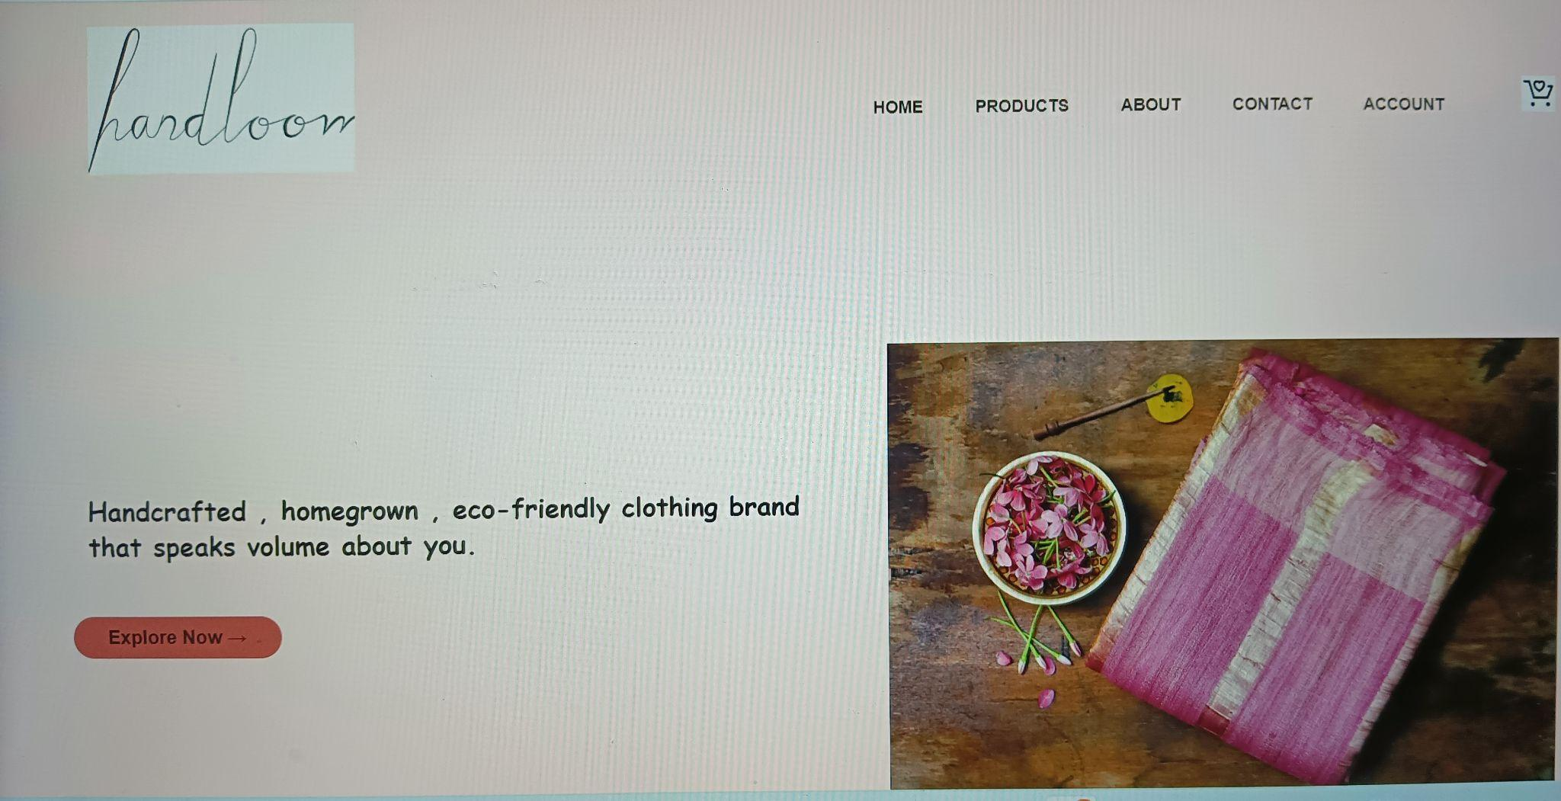

Slide 15
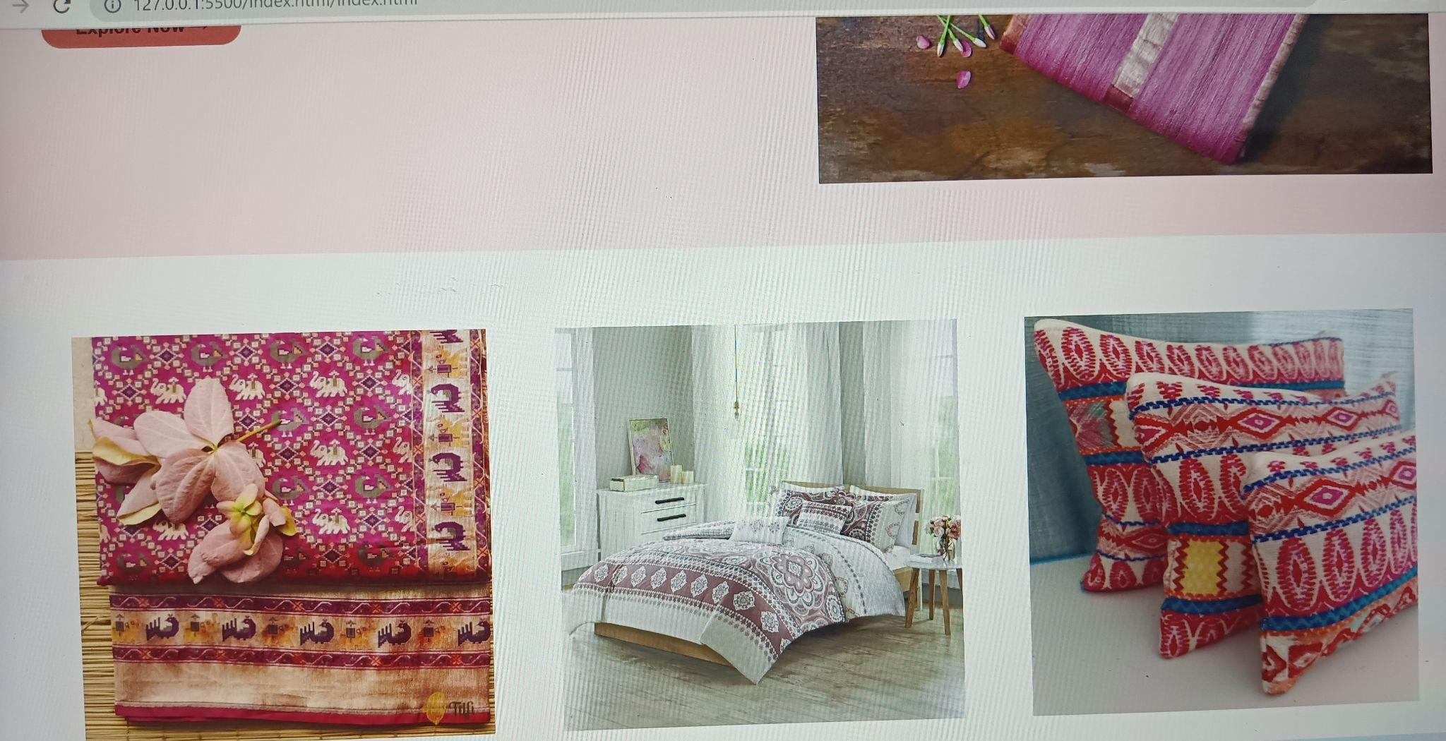

Slide 16
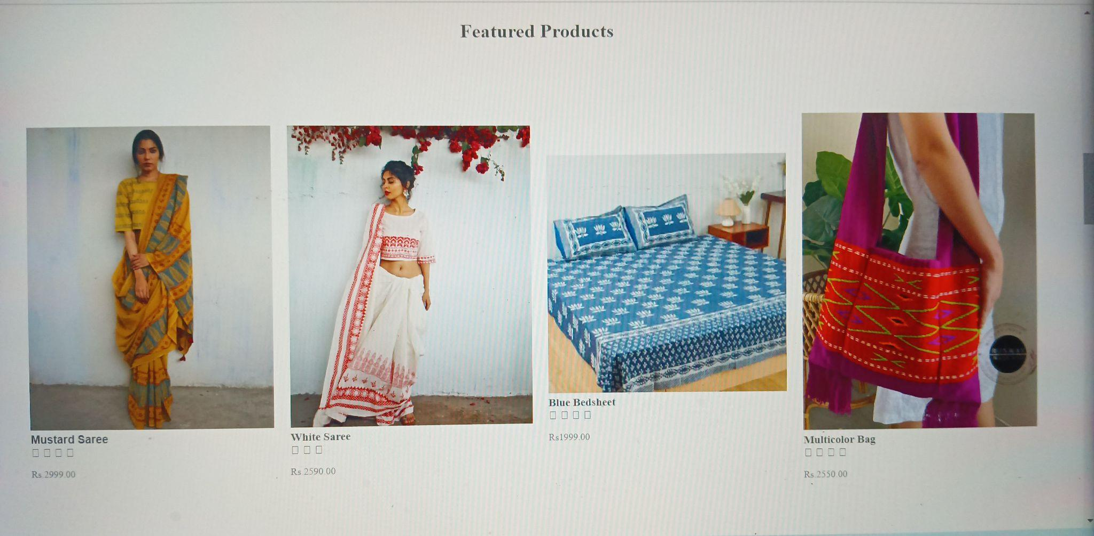

Slide 17
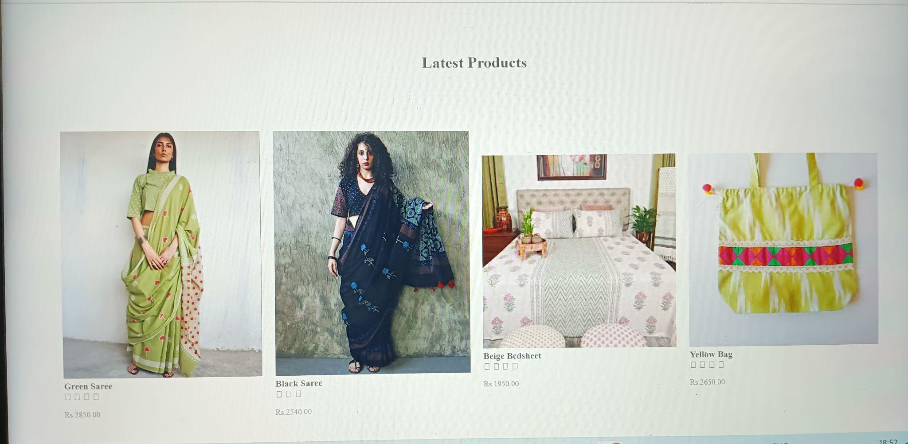

Slide 18
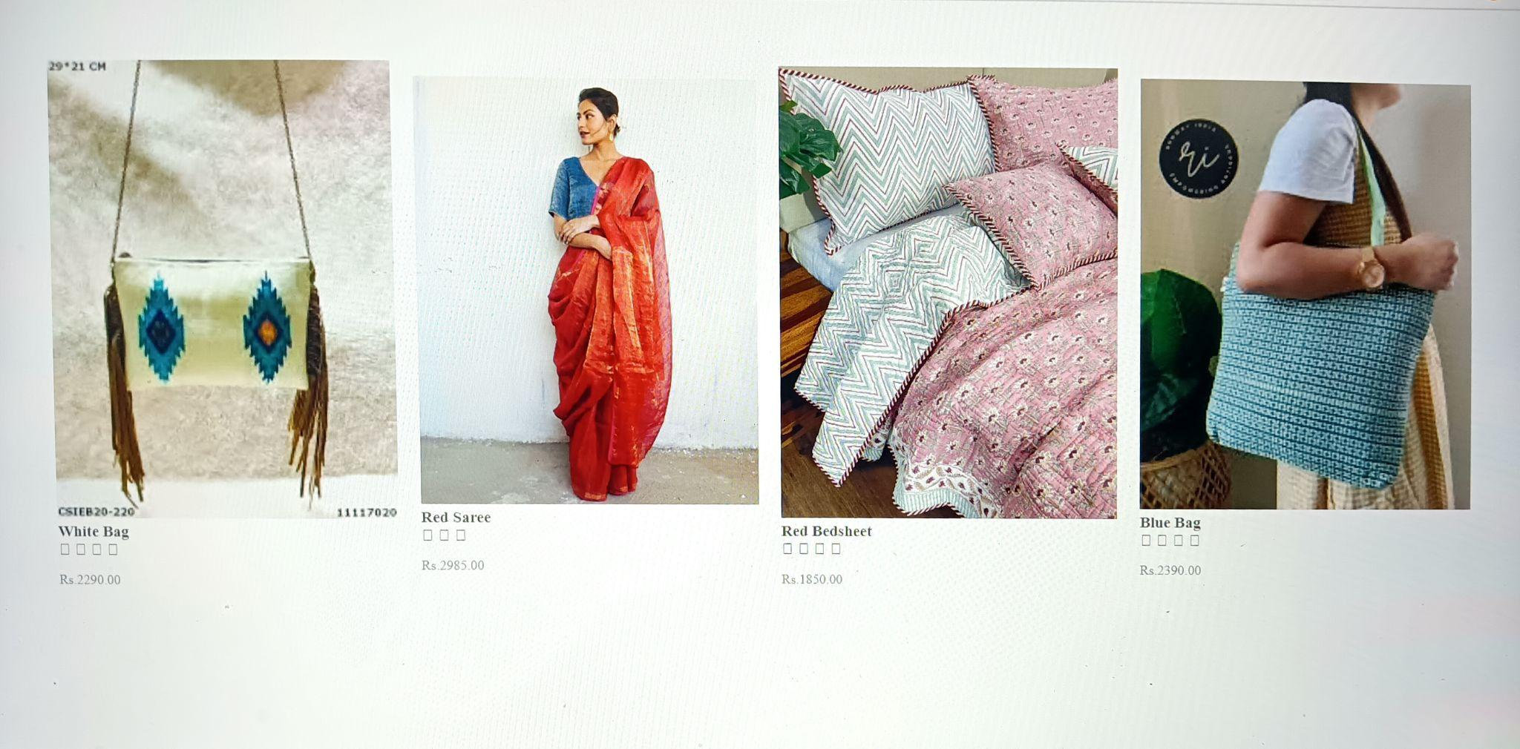

Slide 19

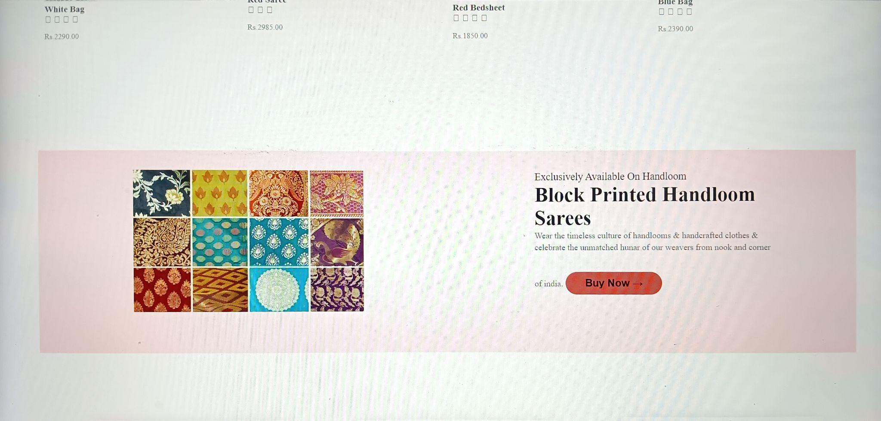

Slide 20
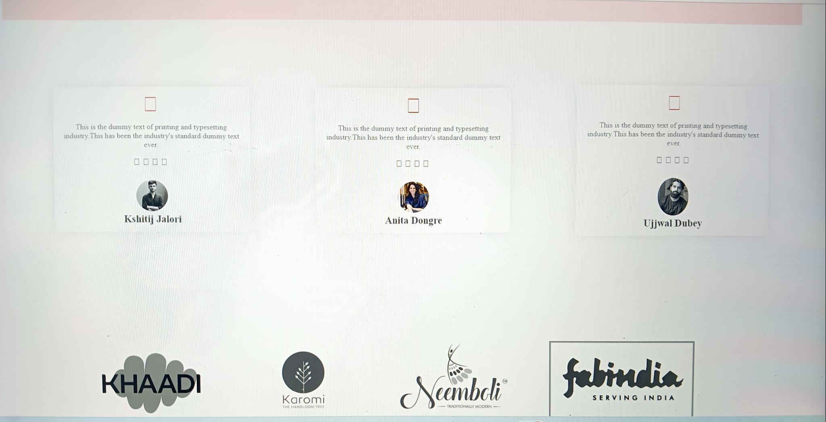

Slide 21
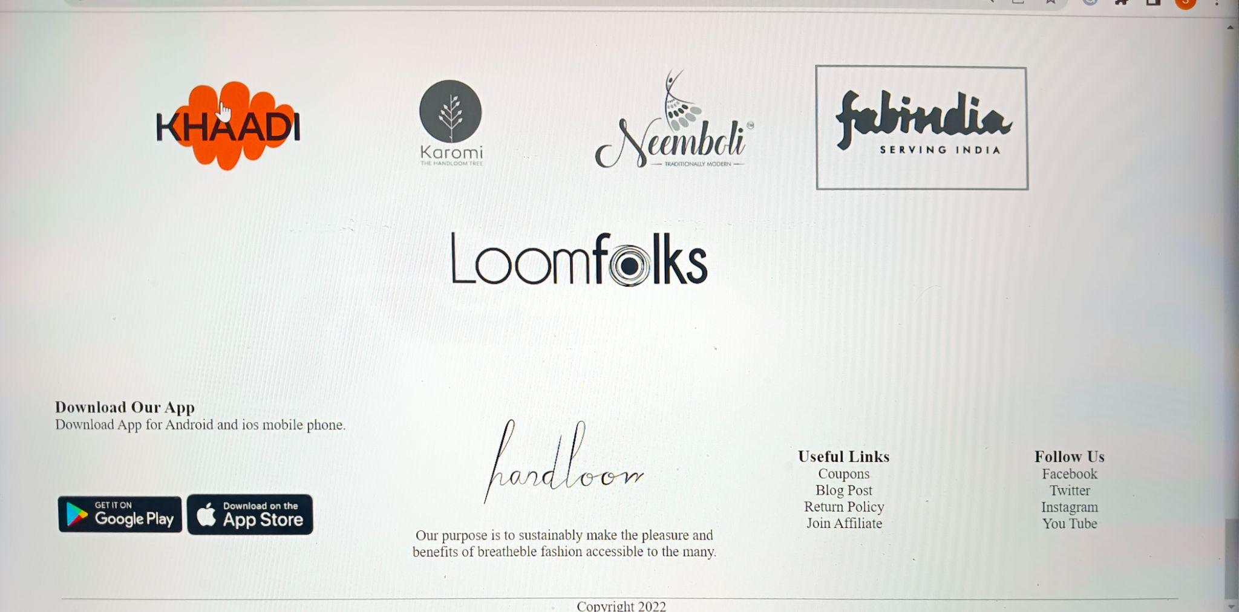

Slide 22
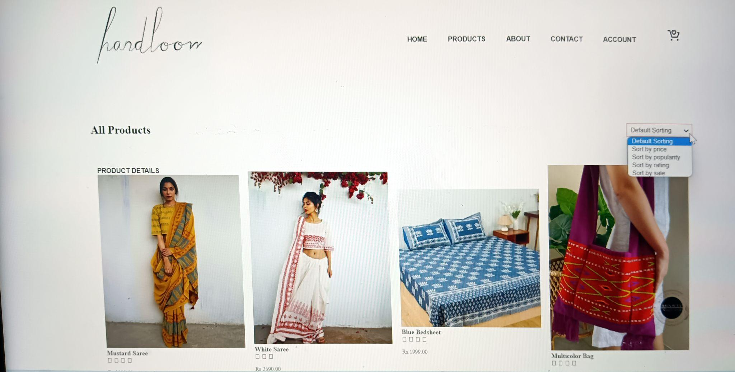

Slide 23
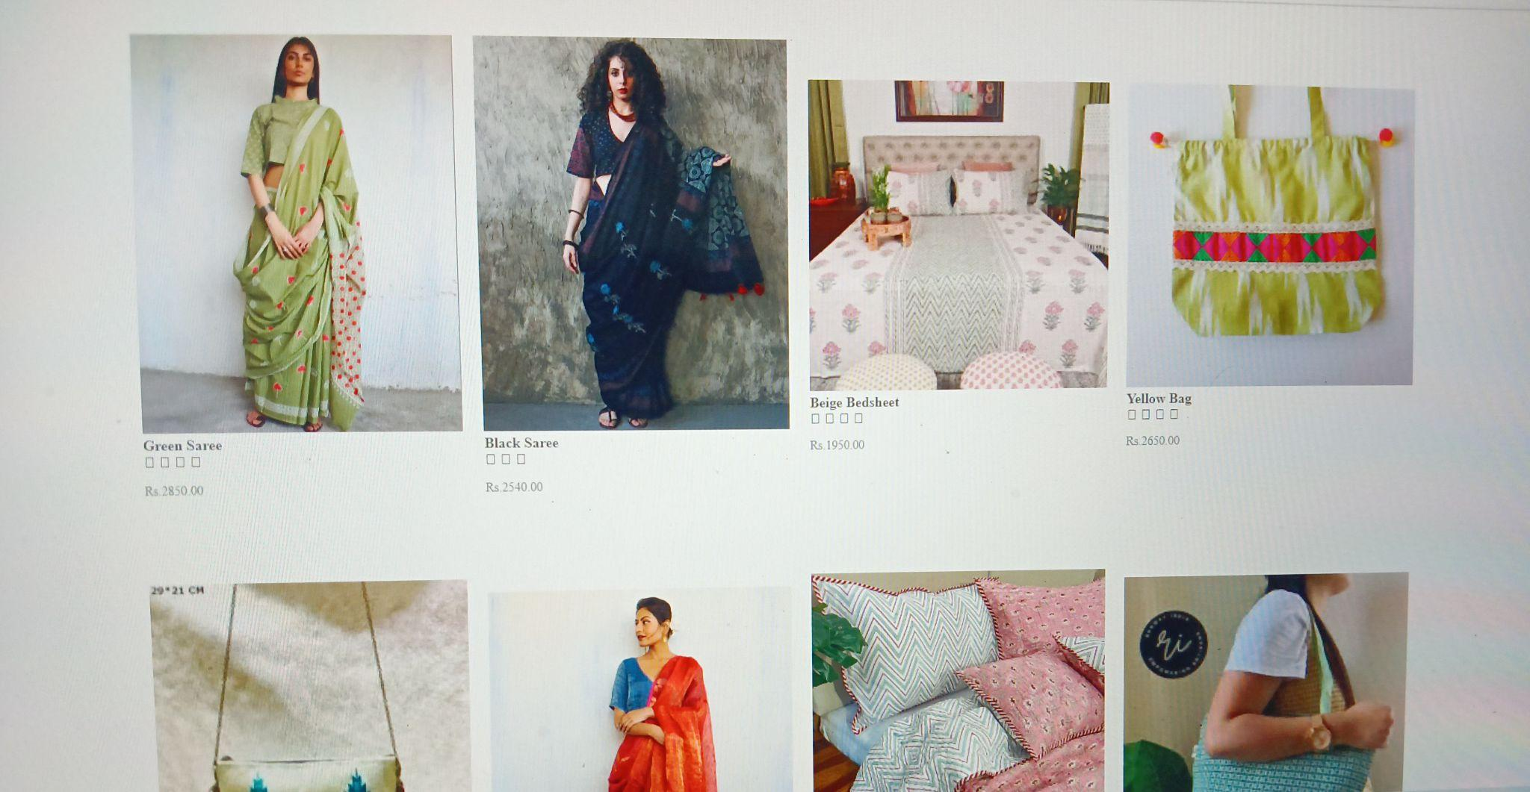

Slide 24
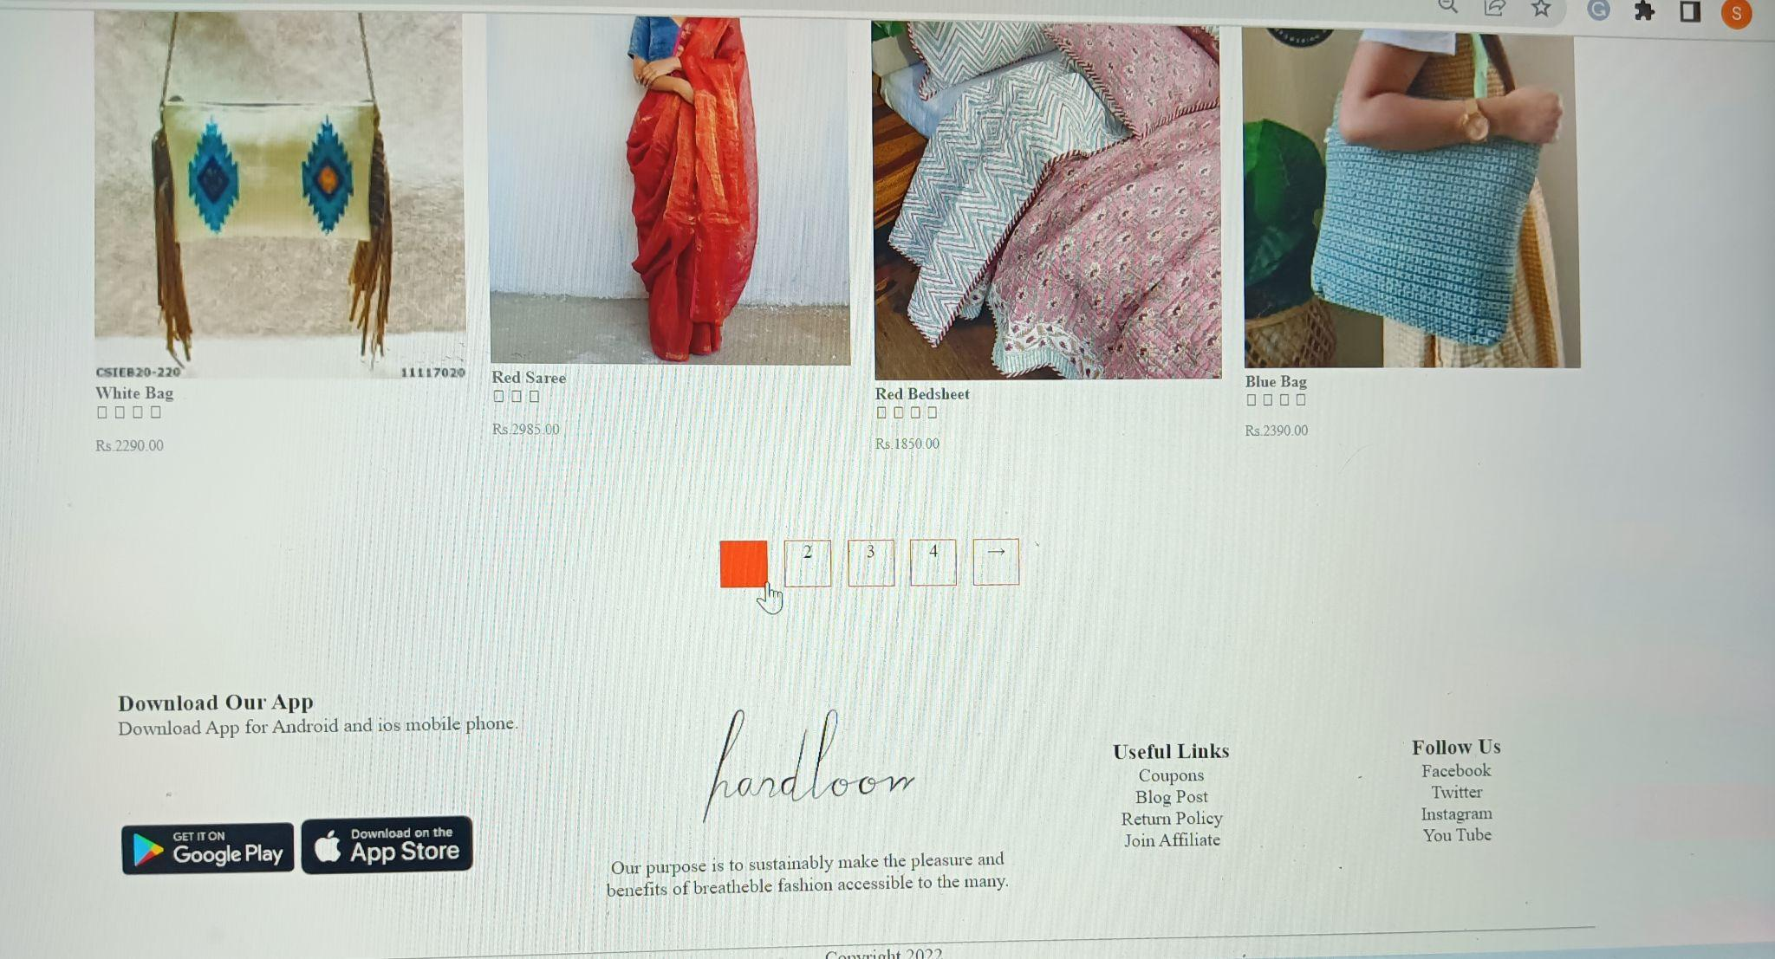

Slide 25
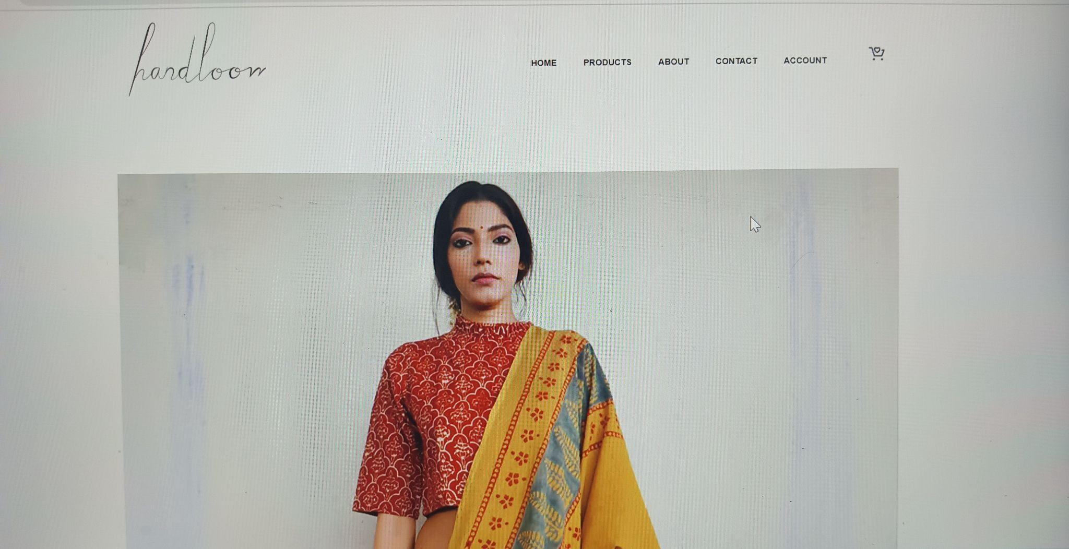

Slide 26
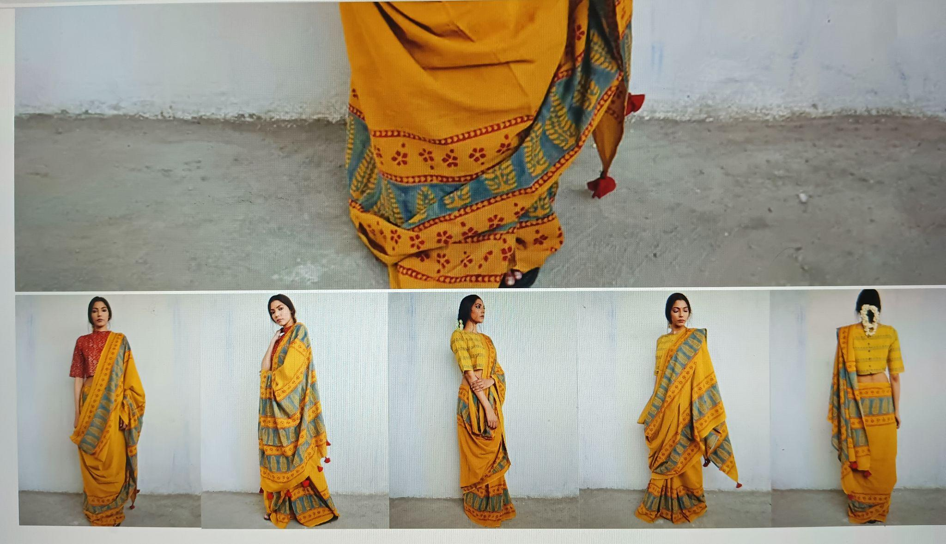

Slide 27
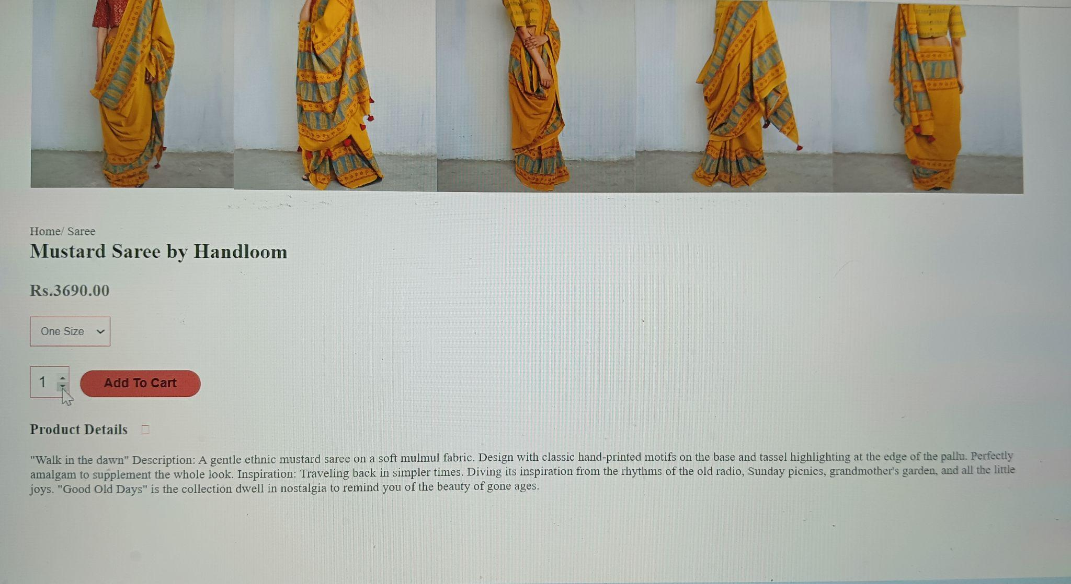

Slide 28
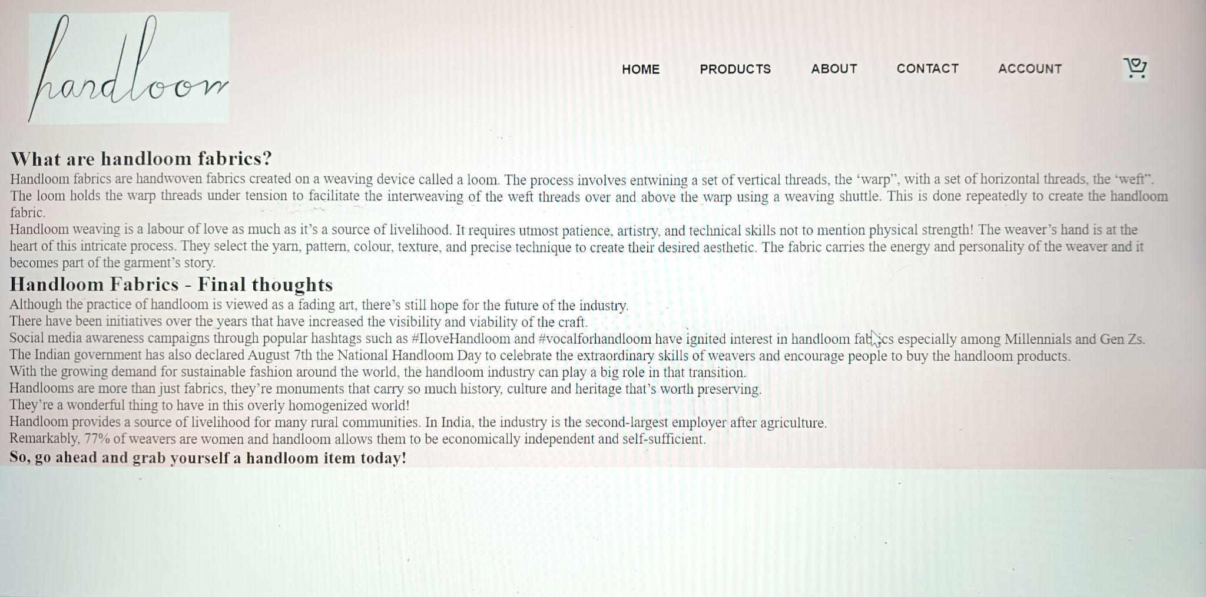

Slide 29
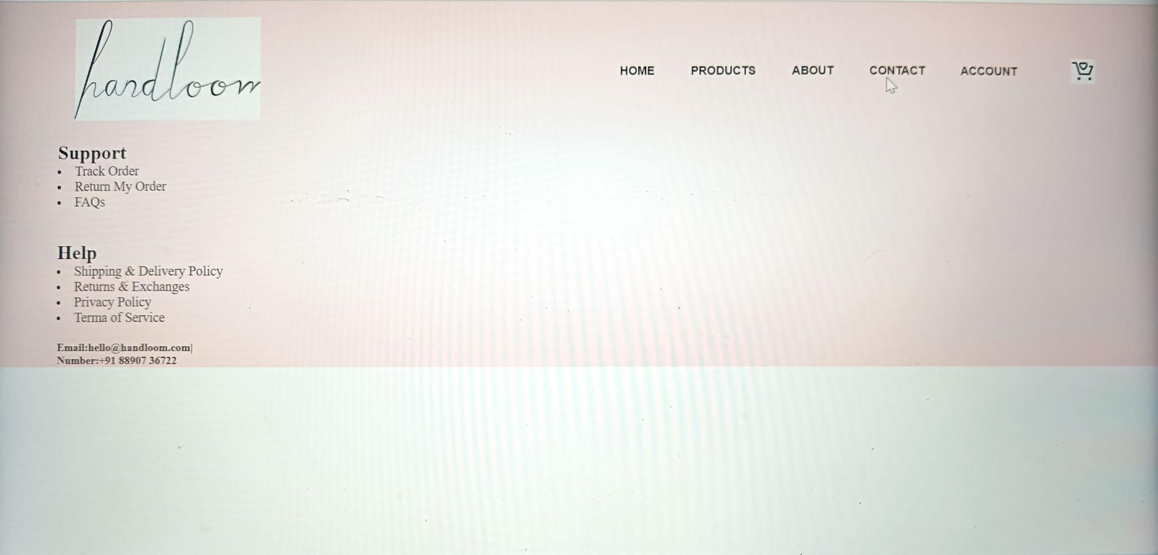

Slide 30
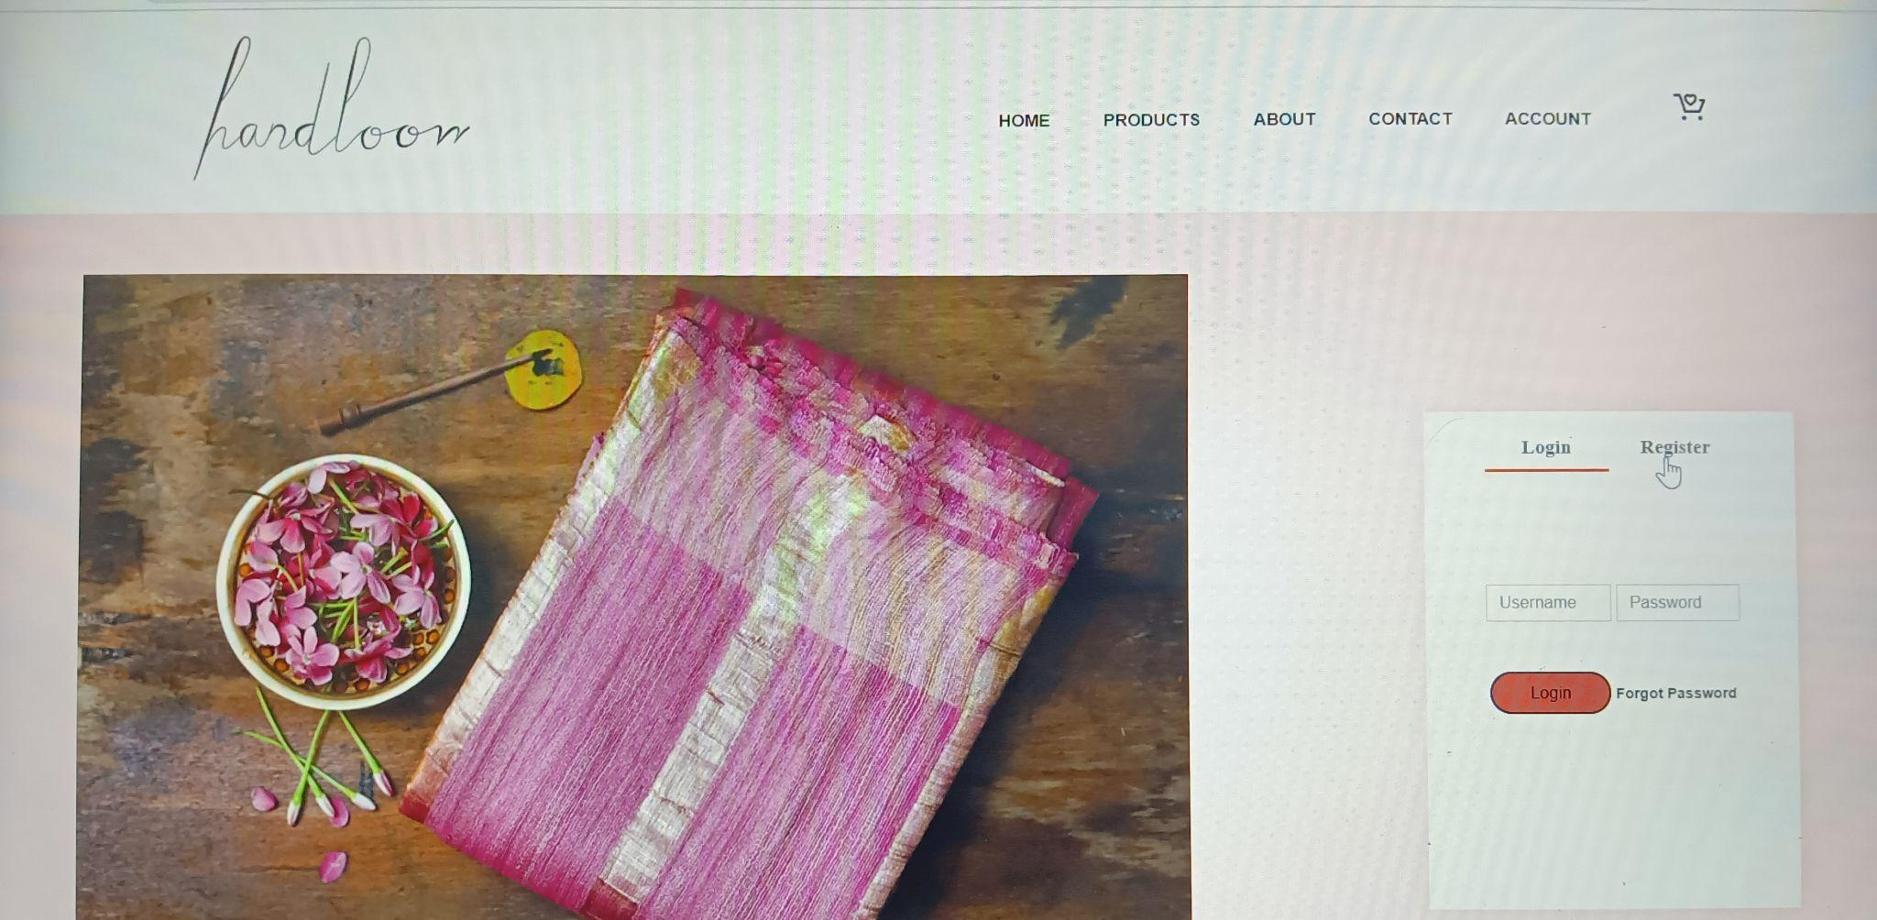

Slide 31
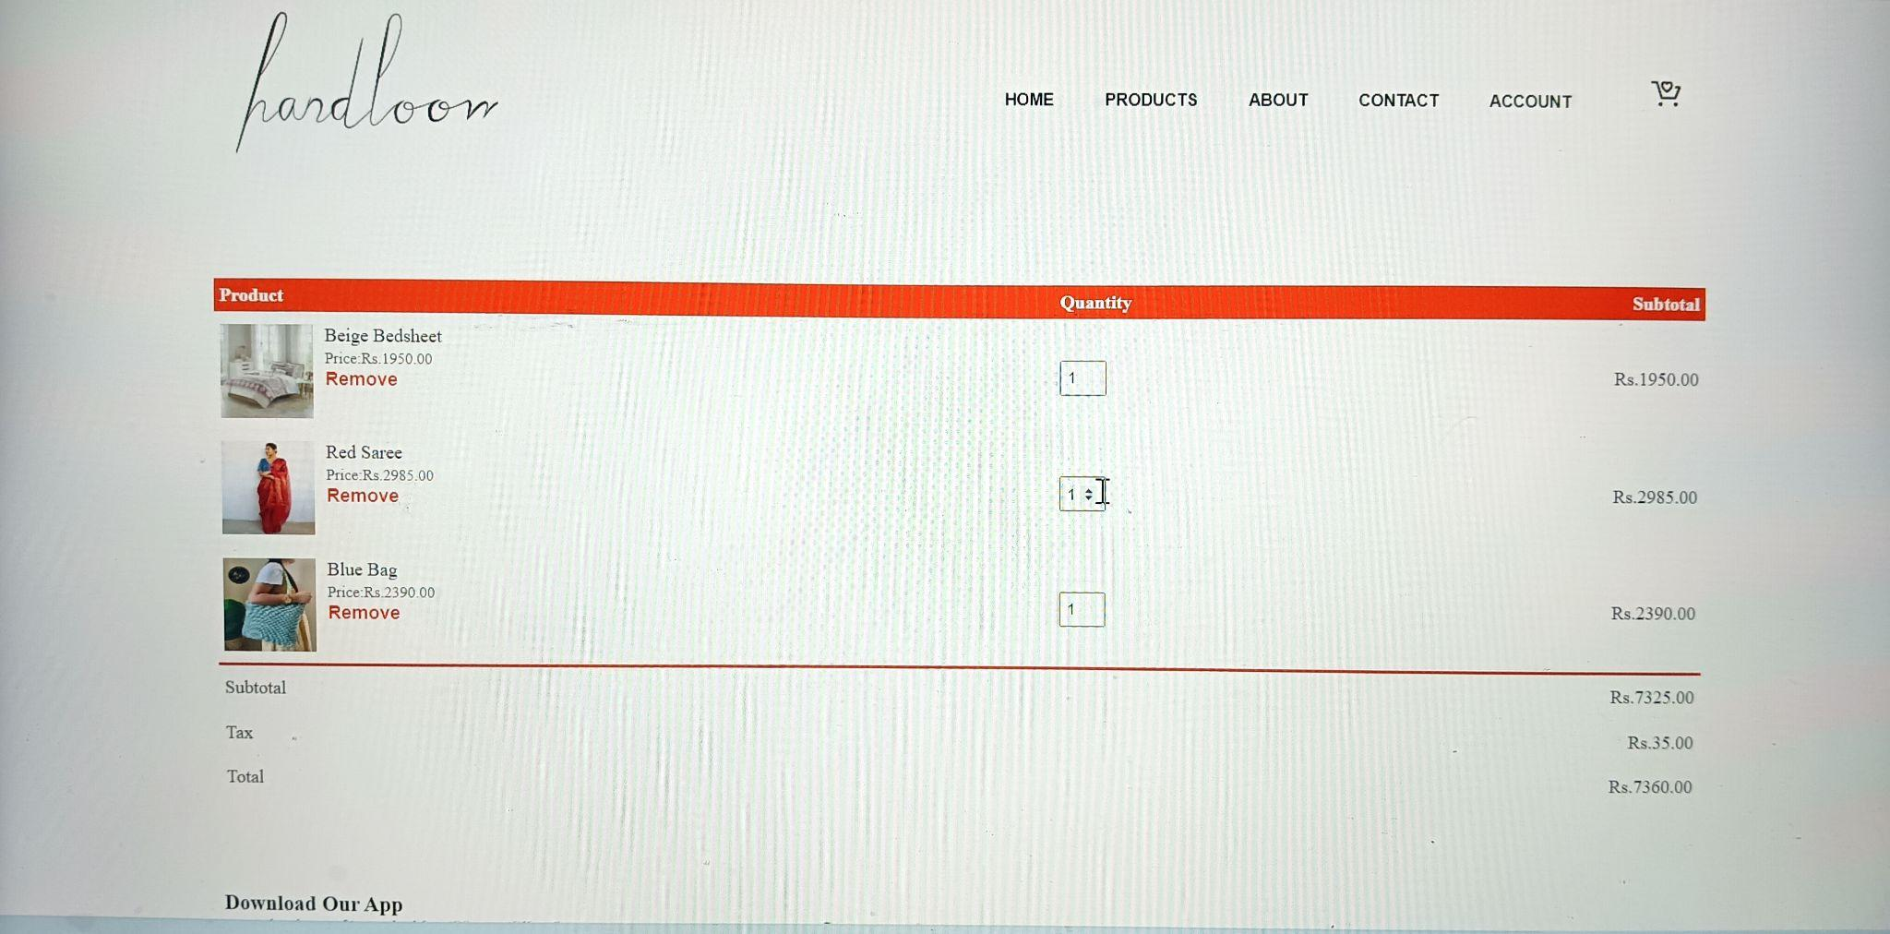

Slide 32
click to visit website

Slide 33
THANK YOU

